Slide 1
BREAK OUT: LIVE SESSION 9

Slide 2
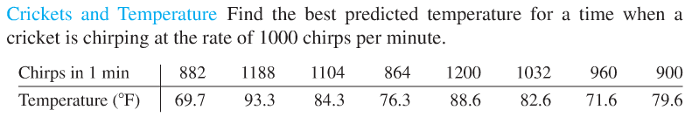
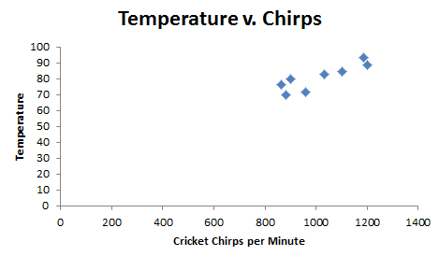
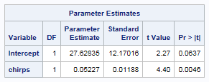
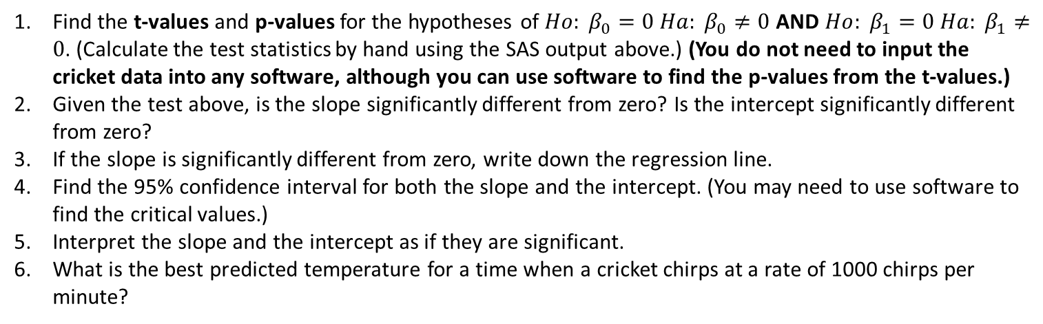
Crickets!!!
It might seem counterintuitive to predict temperature based on the number of chirps (versus the other way around), but that is the question of interest here!
Find the t-values and p-values for the hypotheses of $Ho: β_{0}=0{ Ha: β}_{0}≠0$ AND $Ho: β_{1}=0{ Ha: β}_{1}≠0$. (Calculate the test statistics by hand using the SAS output above.) (You do not need to input the cricket data into any software, although you can use software to find the p-values from the t-values.)
Given the test above, is the slope significantly different from zero? Is the intercept significantly different from zero?
If the slope is significantly different from zero, write down the regression line.
Find the 95% confidence interval for both the slope and the intercept. (You may need to use software to find the critical values.)
Interpret the slope and the intercept as if they are significant.
What is the best predicted temperature for a time when a cricket chirps at a rate of 1000 chirps per minute?

